Slide 1



15 July, 2024
CUSTOMER CHURN PREDICTION
Made By LeHoangDucDuy

Slide 2
INTRODUCTION
Customer churn prediction is a critical aspect of business management, particularly for industries like telecommunications, internet service providers, pay TV companies, insurance firms, and alarm monitoring services. It involves understanding and addressing customer attrition, which refers to the loss of clients or customers.
For businesses in these sectors, measuring customer attrition is a vital business metric. This is because retaining an existing customer is significantly more cost-effective than acquiring a new one. As a result, these companies often have customer service branches dedicated to re-engaging customers who are considering leaving. This is because the long-term value of recovered customers far outweighs that of newly acquired ones.
To address customer churn, predictive analytics comes into play, churn prediction models to assess the likelihood of customers leaving. These models prioritize a small list of potential defectors, enabling businesses to concentrate their customer retention efforts on those who are most at risk of churning.

Slide 3

ABOUT DATA
State: The state where the customer resides, represented by a two-letter code.
Account length: The number of days the customer has been with the current telecom provider.
Area code: The area code for the customer's phone number.
International plan: Indicates whether the customer has an international calling plan (Yes or No).
Voice mail plan: Indicates whether the customer has a voice mail plan (Yes or No).
Number vmail messages: The number of voice mail messages the customer has.
Total day minutes: The total number of minutes the customer has used during the day.
Total day calls: The total number of calls the customer has made during the day.
Total day charge: The total charges incurred by the customer for day-time usage.
Total eve minutes: The total number of minutes the customer has used during the evening.
Total eve calls: The total number of calls the customer has made during the evening.
Total eve charge: The total charges incurred by the customer for evening usage.
Total night minutes: The total number of minutes the customer has used during the night.
Total night calls: The total number of calls the customer has made during the night.
Total night charge: The total charges incurred by the customer for night-time usage.
Total intl minutes: The total number of international minutes the customer has used.
Total intl calls: The total number of international calls the customer has made.
Total intl charge: The total charges incurred by the customer for international usage.
Customer service calls: The number of calls the customer has made to customer service.
Churn: Indicates whether the customer has churned (Yes or No)

Slide 4




ANALYSIS

Slide 5
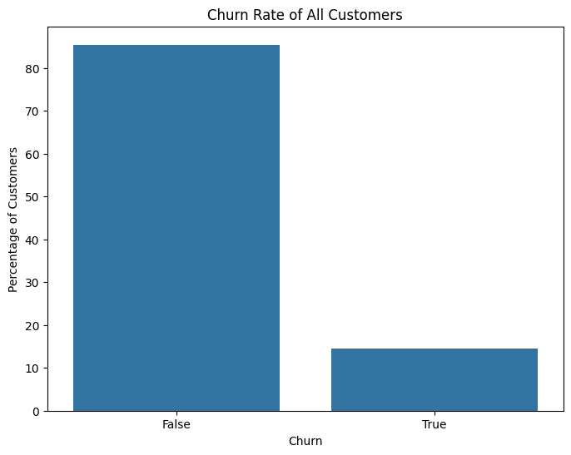
CHURN RATE
Looking at the chart, we can see that the percentage of customers who have not abandoned the service is quite high (about over 80%), while more than 10% of customers have abandoned the service.

Slide 6
2. ANALYZE SERVICE USAGE BEHAVIOR

Slide 7
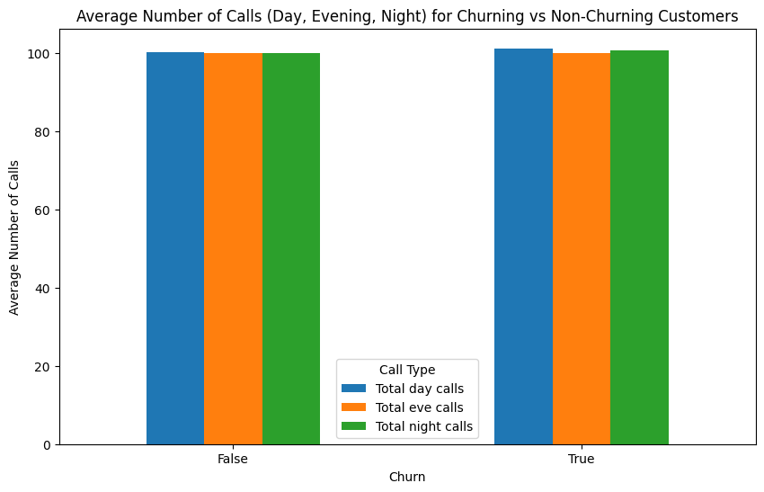
2.1 FIND OUT WHETHER CHURNING CUSTOMERS TEND TO CALL MORE OR LESS DURING THE DAY, EVENING, AND NIGHT THAN NON-CHURNING CUSTOMERS?
From the chart above, it can be seen that the number of calls (whether during the day, evening or night) has no significant difference between churning and non-churning customers.
Call volume is not the main factor influencing whether a customer churns or not. Therefore, to reduce churn rate, it is necessary to consider other factors such as call duration, service plan (voice mail, international plan), and customer service satisfaction level.

Slide 8
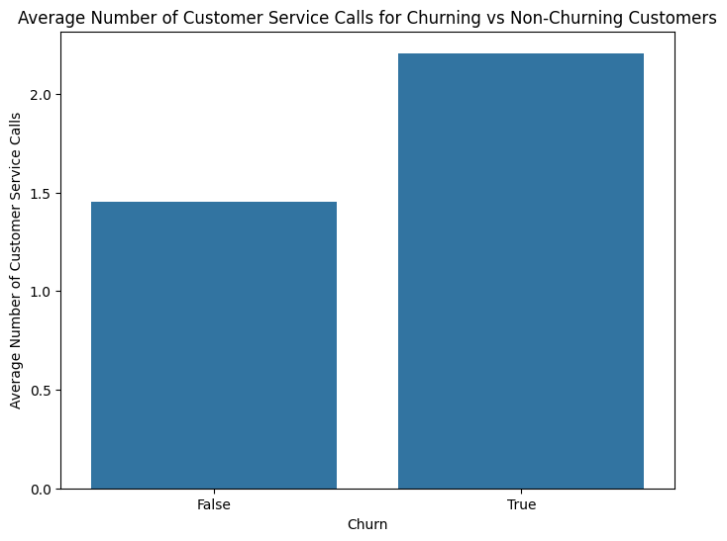
2.2 FIND OUT WHETHER CHURNING CUSTOMERS TEND TO MAKE MORE CUSTOMER SERVICE CALLS THAN NON-CHURNING CUSTOMERS?
Churning customers have a higher average number of calls to customer service than non-churning customers.
This shows that churning customers are more likely to call customer service.
A high number of calls to customer service can be a sign of dissatisfaction or problems with service.
Customers often call customer service multiple times when they encounter unresolved problems or are dissatisfied with the service received.

Slide 9
3. SERVICE COST ANALYSIS

Slide 10
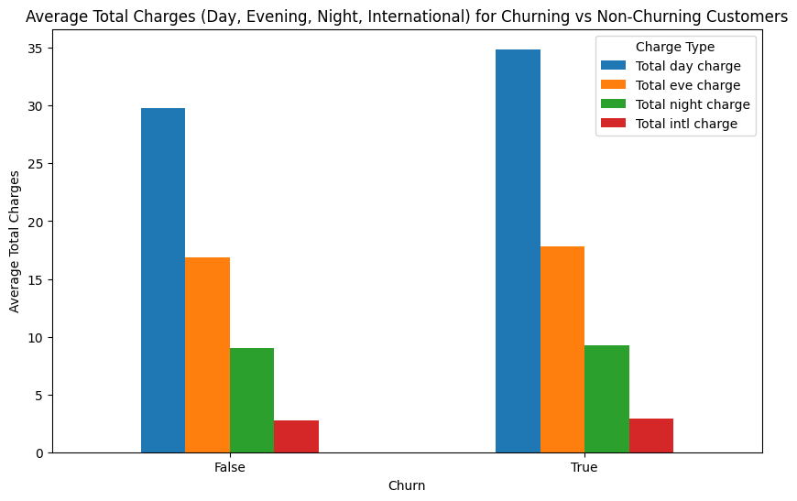
3.1 DOES THE TOTAL COST (DAY CHARGE, EVE CHARGE, NIGHT CHARGE, INTL CHARGE) AFFECT THE CUSTOMER'S CHURN DECISION?
The chart indicates that there is no significant difference in the total charges (day, evening, night, and international) between churning and non-churning customers. This suggests that call charges alone may not be a key determinant of customer churn, and other factors might be contributing to why customers decide to leave.

Slide 11
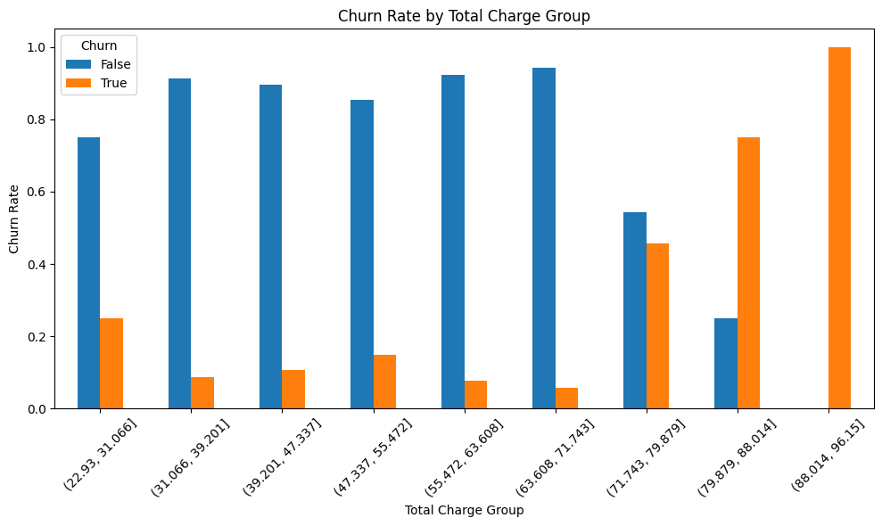
3.2 FIND OUT IF CUSTOMERS WITH HIGHER TOTAL COSTS HAVE HIGHER OR LOWER CHURN RATES?
Low cost group (22.93 - 31,066): Non-churn customers account for a high rate, while the churn rate of customers is significantly lower.
Average cost group (31,066 - 71,143): These groups show a similar pattern: the rate of non-churn customers dominates, while the rate of churn customers is very low.
High cost group (71,143 - 79,879): The rate of customer churn begins to increase compared to the average cost group, while the rate of non-churn customers decreases.
Very high cost group (79,879 - 96.15): The customer churn rate is the highest in all groups, far exceeding the non-churn customer rate. This shows that customers with very high total costs tend to churn more.
Conclusion: The graph shows that customers with high total costs are more likely to churn. While the low and medium total cost groups mainly consist of non-churn customers, customer churn increases sharply in the high total cost groups. This suggests that high costs may be a major factor in customers deciding to churn.

Slide 12
4. CUSTOMER SERVICE ANALYSIS

Slide 13
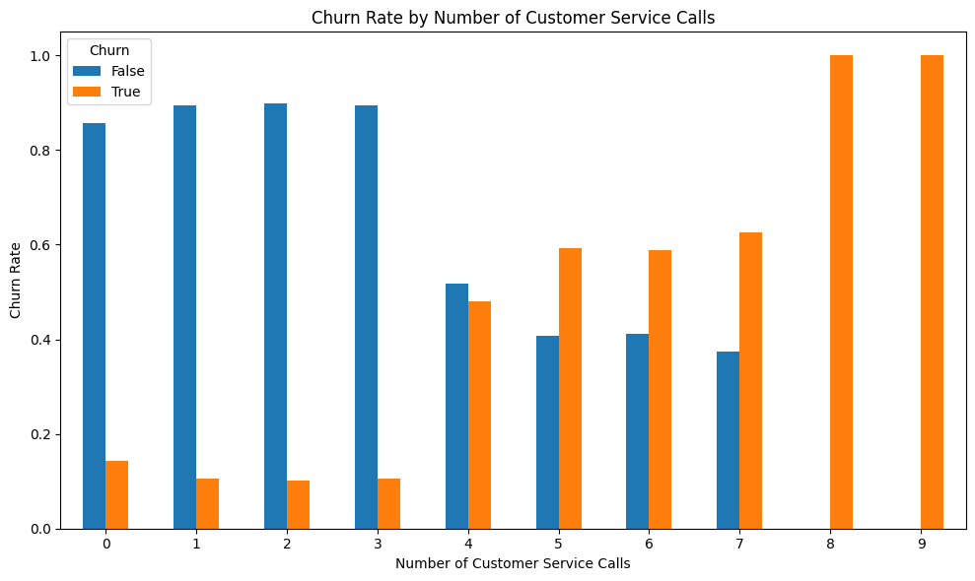
4.1 DOES THE NUMBER OF CALLS TO CUSTOMER SERVICE HAVE ANYTHING TO DO WITH CHURN RATE?
High cancellation rates: The chart shows high cancellation rates, especially for customers with many customer service calls. This suggests that there is a negative relationship between the number of customer service calls and service cancellation rates. Customers with more customer service calls are more likely to cancel service.
Customers who have many customer service calls may experience many problems with the product or service. This can lead to frustration and eventual cancellation of the service.
Customers who have many customer service calls may feel that they are not receiving good customer service. This can also lead to frustration and eventual cancellation of the service.

Slide 14
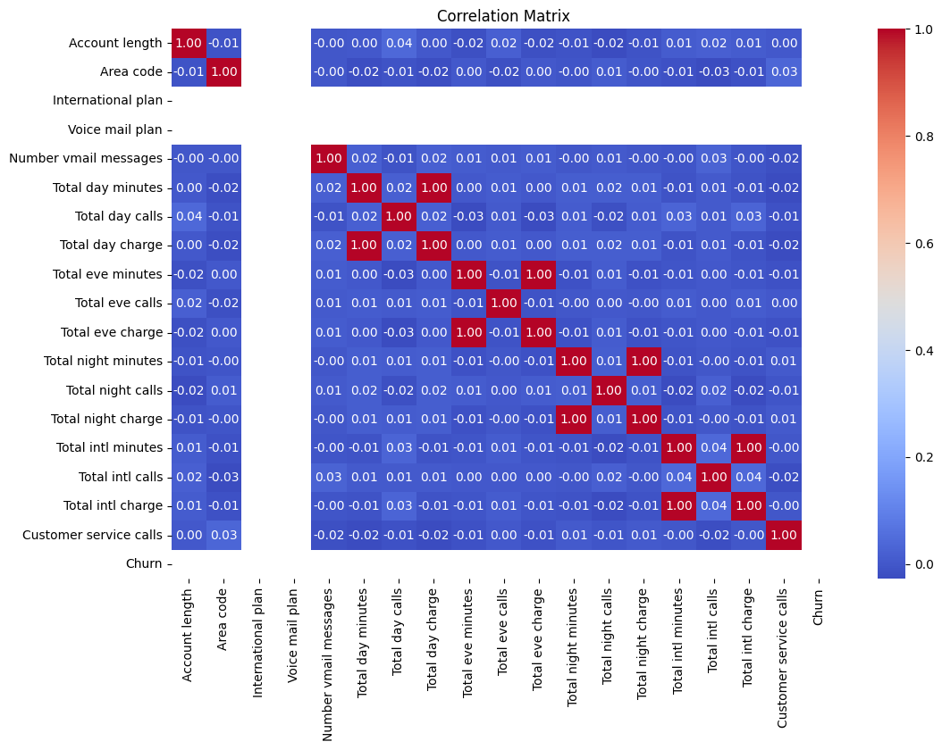
5. HEATMAP

Slide 15

CONCLUSION

Slide 16
Churn Rate: A significant portion of customers (over 10%) have churned, indicating a need for retention strategies.
Service Usage: Call volume alone doesn't strongly predict churn. However, churning customers tend to make more customer service calls, suggesting dissatisfaction or unresolved issues.
Service Cost: While total charges don't differ significantly between churned and retained customers, those with very high costs are more likely to churn, highlighting the importance of cost-effectiveness.
Customer Service: A strong negative correlation exists between the number of customer service calls and churn rate. Addressing customer service issues and improving satisfaction are crucial for reducing churn.
Recommendations:
Proactively address customer service issues to prevent escalation and dissatisfaction.
Offer cost-effective plans and promotions to retain price-sensitive customers.
Implement targeted retention strategies for high-risk customers, such as those with high costs or frequent customer service interactions.
Continuously monitor customer satisfaction and feedback to identify areas for improvement.

Slide 17
MODELING

Slide 18

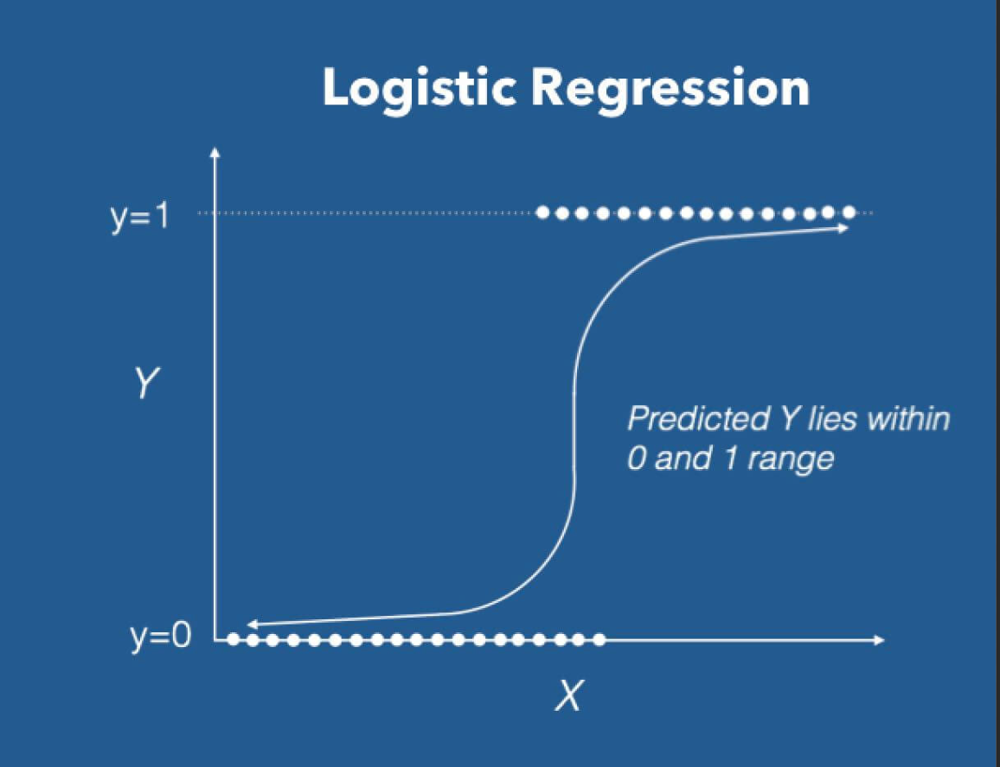
MODEL SELECTION
Logistic Regression

Slide 19

International plan
Voice mail plan
Total day minutes
Total eve minutes
Total night minutes
Total intl minutes
Customer service calls
FEATURE INPUT

Slide 20
FEATURE IMPORTANT
Customer Service Calls: High importance as frequent interactions often indicate dissatisfaction.
Total Day Minutes: Significant as higher usage might correlate with higher dissatisfaction.
International Plan: Indicates whether the lack of certain plans affects customer retention.
Voice Mail Plan: Suggests if additional services are valued by customers.

Slide 21

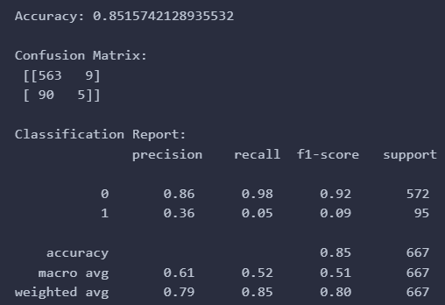
RESULT

Slide 22
KEY QUESTIONS

Slide 23
WHAT IS THE SIGNIFICANCE OF CHURN RATE FOR STAKEHOLDERS (CUSTOMERS, MCI, ETC.)?
Churn rate, the percentage of customers who discontinue their subscription to a service within a given time period, is a critical metric for various stakeholders:
Customers: High churn rates may indicate dissatisfaction among customers due to poor service quality, high prices, or lack of product features. Understanding churn can lead to improved services and better customer satisfaction.
MCI (Company): For the company, a high churn rate directly impacts revenue and profitability. Retaining existing customers is generally more cost-effective than acquiring new ones. Churn rate analysis helps MCI identify areas needing improvement, refine customer retention strategies, and enhance customer lifetime value.
Investors: Investors view churn rate as a key indicator of a company's health and growth potential. A high churn rate can signal potential problems, while a low churn rate suggests customer satisfaction and business stability, influencing investment decisions.
Competitors: Competitors can analyze churn rates to identify weaknesses in MCI's offerings and capitalize on them by attracting dissatisfied customers with better deals or improved services.

Slide 24
2. WHAT ARE THE CHARACTERISTICS OF EACH TYPE OF CUSTOMER (CHURN OR NOT CHURN)?
Churn Customers:
Higher Usage of Customer Service: Customers who churn often have more customer service interactions, indicating unresolved issues or dissatisfaction.
Higher Daytime Usage: They may exhibit higher total day minutes, possibly seeking better value or service elsewhere.
Non-Engagement with Additional Plans: Churning customers might not utilize international or voice mail plans, suggesting these services are not meeting their needs or are perceived as unnecessary.
Non-Churn Customers:
Lower Usage of Customer Service: They have fewer customer service interactions, indicating fewer issues or greater satisfaction with the service.
Balanced Usage: Non-churn customers tend to have balanced usage across day, evening, and night minutes, indicating satisfaction with the service levels.
Engagement with Additional Plans: These customers are more likely to use international and voice mail plans, suggesting these services add value and enhance their overall experience.

Slide 25
3. WHICH ML MODELING CAN BE IMPLEMENTED AND REPRESENT MODEL RESULTS? INCLUDING FEATURES INPUT AND EXPLAINING FEATURES IMPORTANT.
Model Selection:
Logistic Regression: Suitable for binary classification problems like churn prediction.
Random Forest: Provides insights into feature importance and handles large datasets well.
Support Vector Machines (SVM): Effective for higher-dimensional spaces and non-linear relationships.
Gradient Boosting Machines (GBM): Offers high performance with boosting techniques to improve prediction accuracy.
Features Input:
International plan
Voice mail plan
Total day minutes
Total eve minutes
Total night minutes
Total intl minutes
Customer service calls
Feature Importance:
Customer Service Calls: High importance as frequent interactions often indicate dissatisfaction.
Total Day Minutes: Significant as higher usage might correlate with higher dissatisfaction.
International Plan: Indicates whether the lack of certain plans affects customer retention.
Voice Mail Plan: Suggests if additional services are valued by customers.

Slide 26
4. WHAT ACTIONS REGARDING QUALITATIVE AND QUANTITATIVE ANALYTICS COULD BE IMPLEMENTED TO ENHANCE RETENTION RATE?
Qualitative Analytics:
Customer Feedback: Regularly collect and analyze customer feedback to identify pain points and areas for improvement.
Focus Groups: Conduct focus groups with churned and non-churned customers to gain deeper insights into their experiences and expectations.
Surveys: Implement surveys targeting satisfaction, service quality, and feature needs to gather actionable insights.
Quantitative Analytics:
Churn Prediction Models: Develop and deploy predictive models to identify customers at high risk of churning and proactively address their issues.
Usage Patterns Analysis: Analyze usage patterns to understand how different features are used and their correlation with churn.
Customer Segmentation: Segment customers based on usage, demographics, and behavior to tailor retention strategies effectively.
A/B Testing: Test different retention strategies (e.g., loyalty programs, discounts, service improvements) and measure their effectiveness in reducing churn.

Slide 27
THANK YOU

